Slide 1

Event Management Database
Ryan Pierce

Slide 2
AGENDA
Schema Overview
Venue Table
​Event Table
Session Table
​Speaker Table​
Attendee Table
Ticket Table
Python Program Features
Dynamic Relationships
Conclusion

Slide 3
Schema Overview
The Event Management Database consists of six interconnected tables:
Venue Table
Event Table
Session Table
Speaker Table
Attendee Table
Ticket Table
Each table serves a specific purpose in managing event-related information.
Let's explore the structure and functionalities of each table to understand how they contribute to seamless event management.

Slide 4
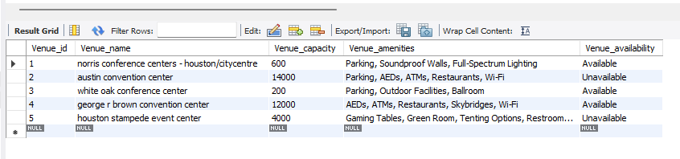
Venue Table
The Venue Table in our Event Management Database stores essential information about various event venues.
Columns:
Venue_id: Unique identifier for each venue.
Venue_name: Name of the venue.
Venue_capacity: Maximum capacity of the venue for attendees.
Venue_amenities: List of amenities available at the venue.
Venue_availability: Indicates the current availability status of the venue.
This table assists event planners in making informed decisions about the ideal venue for each event.

Slide 5

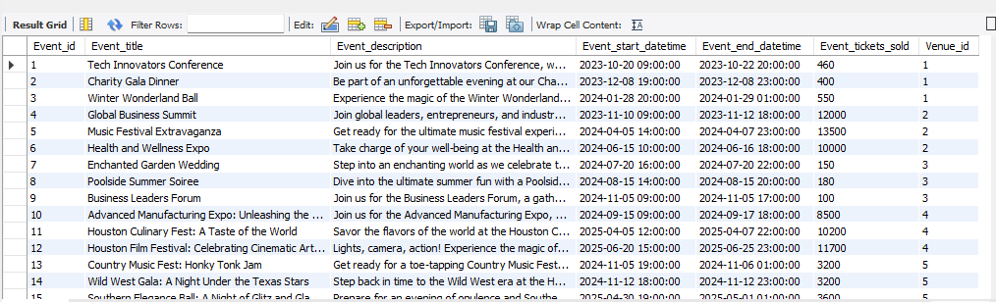
Event Table
The Event Table is a key component of our Event Management Database, responsible for storing comprehensive information about each event.
Columns:
Event_id: Unique identifier for each event.
Event_title: The title or name of the event.
Event_description: A brief description of the event's purpose or content.
Event_start_datetime: The date and time when the event is scheduled to start.
Event_end_datetime: The date and time when the event is expected to conclude.
Event_tickets_sold: The number of tickets sold for the event.
Venue_id: The unique identifier linking the event to its corresponding venue.
The Event Table's seamless integration with other tables enables efficient event planning and tracking.

Slide 6
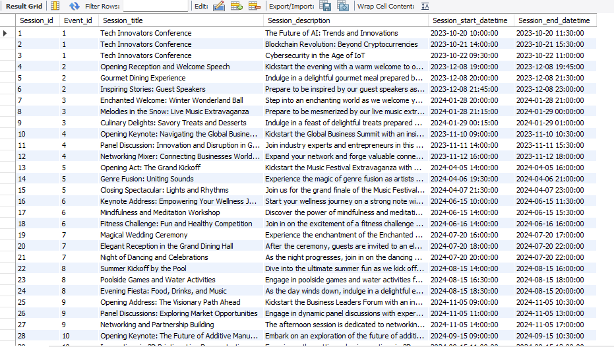
Session Table
The Session Table is a vital component of our Event Management Database, managing details about individual sessions within each event.
Columns:
Session_id: Unique identifier for each session.
Event_id: The identifier linking the session to its parent event.
Session_title: The title or name of the session.
Session_description: A brief description of the session's content or topic.
Session_start_datetime: The date and time when the session is scheduled to start.
Session_end_datetime: The date and time when the session is expected to conclude.
The Session Table's connection with other tables ensures proper organization and management of event sessions.

Slide 7
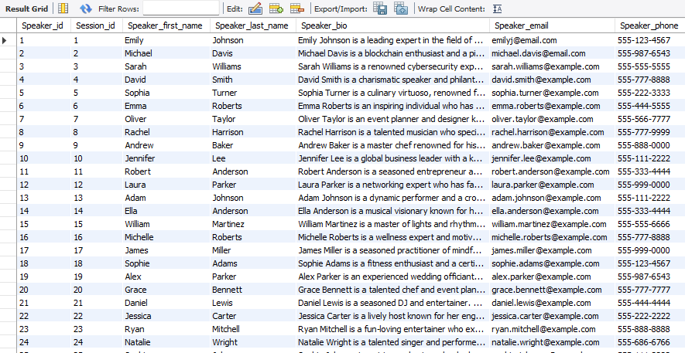
Speaker Table
The Speaker Table is a pivotal component of our Event Management Database, responsible for managing information about the esteemed speakers participating in various event sessions.
Columns:
Speaker_id: Unique identifier for each speaker.
Session_id: The identifier linking the speaker to their respective session.
Speaker_first_name: The first name of the speaker.
Speaker_last_name: The last name of the speaker.
Speaker_bio: A brief biography of the speaker, showcasing their expertise and background.
Speaker_email: Contact email of the speaker.
Speaker_phone: Contact phone number of the speaker.
The Speaker Table plays a critical role in enriching the event experience by providing valuable insights into the speakers' profiles and expertise.

Slide 8
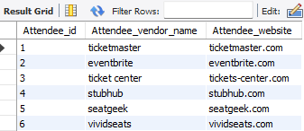
Attendee Table
The Attendee Table is a significant component of our Event Management Database, responsible for recording information about the entities, such as websites or vendors, purchasing event tickets.
Columns:
Attendee_id: Unique identifier for each attendee.
Attendee_vendor_name: The name of the entity (website/vendor) purchasing tickets.
Attendee_website: The website associated with the attendee, facilitating easy contact and access.
The Attendee Table provides crucial data on ticket purchasers, allowing event organizers to understand attendee demographics and preferences.

Slide 9
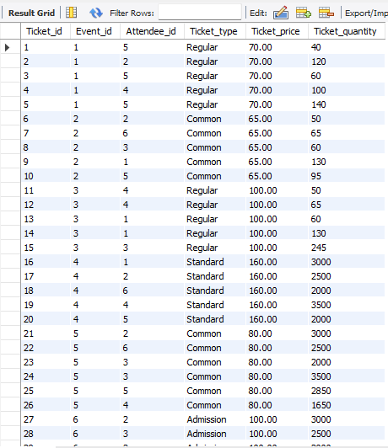
Ticket Table
The Ticket Table is a fundamental aspect of our Event Management Database, responsible for managing all ticket-related data, including ticket types, prices, quantities, and their association with events and attendees.
Columns:
Ticket_id: Unique identifier for each ticket.
Event_id: The identifier linking the ticket to its corresponding event in the Event Table.
Attendee_id: The identifier linking the ticket to its purchaser in the Attendee Table.
Ticket_type: The type or category of the ticket (e.g., VIP, General Admission).
Ticket_price: The price of the ticket.
Ticket_quantity: The number of tickets purchased for the event.
The Ticket Table's dynamic relationship with the Event Table ensures real-time updates to event ticket sales data.
By efficiently managing ticket information, the Ticket Table contributes to accurate event revenue tracking and a seamless ticketing experience for attendees.

Slide 10
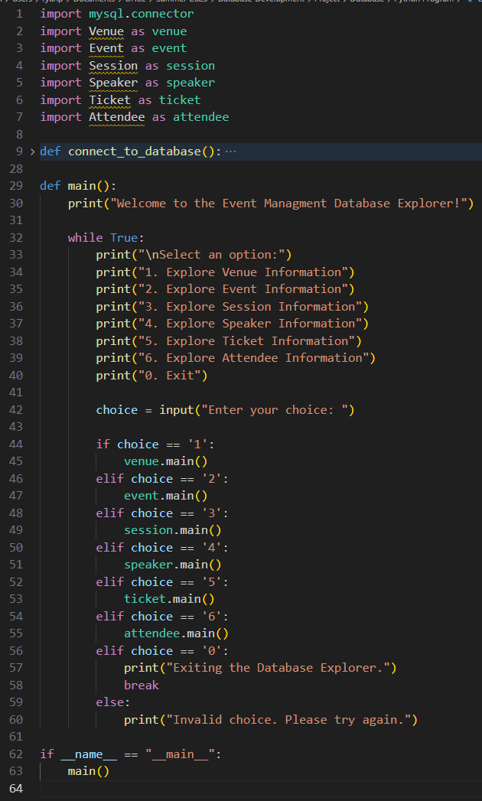
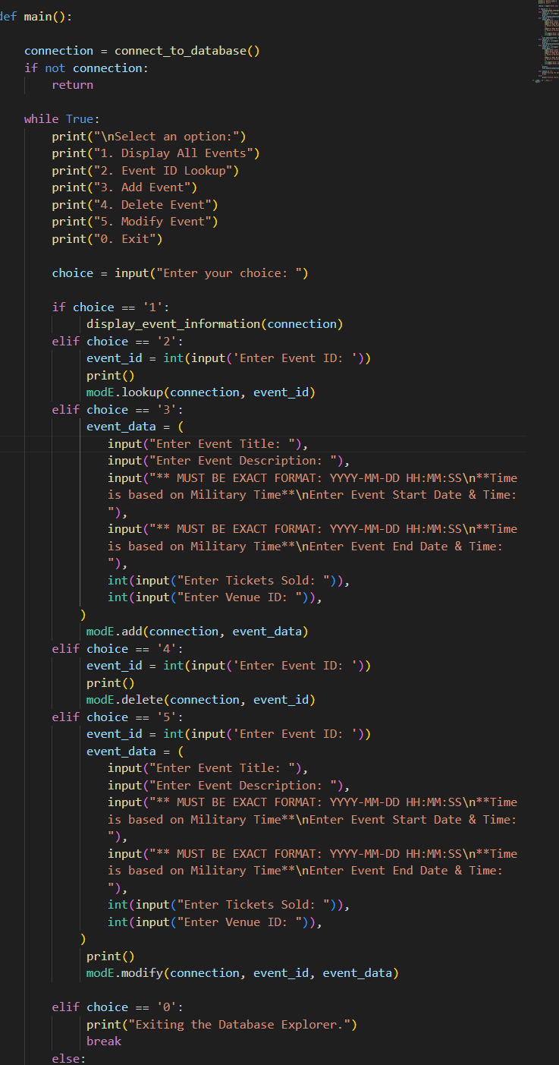
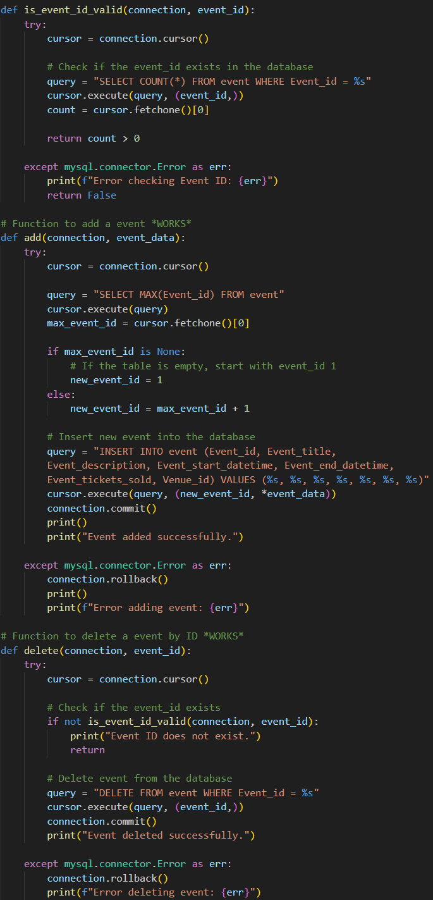
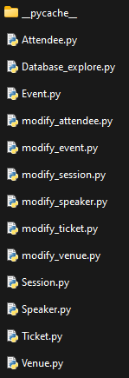

Slide 11
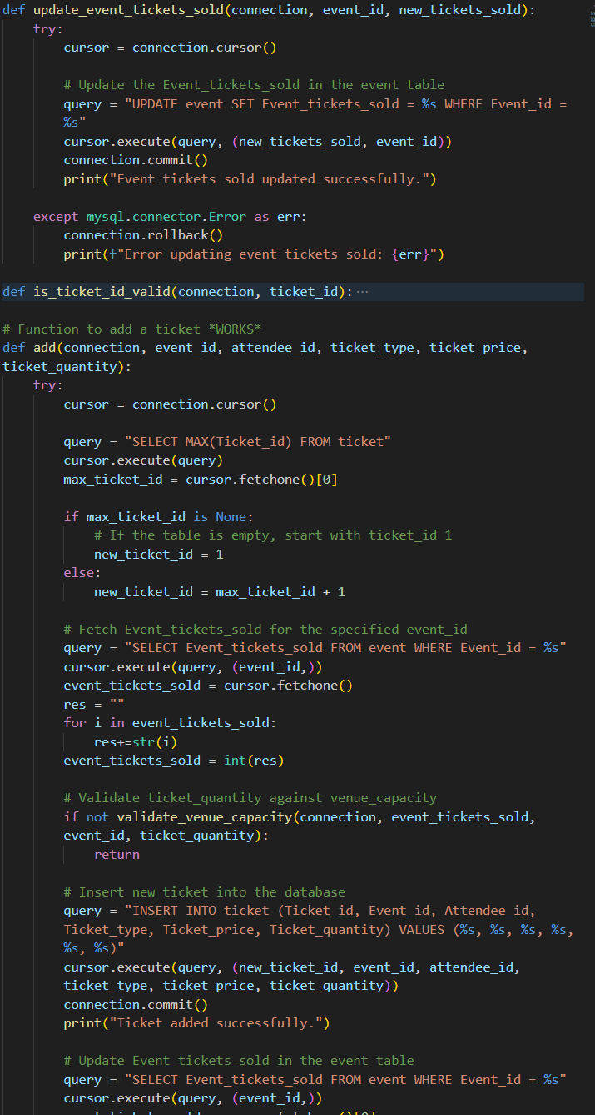
Dynamic Relationships
One of the key strengths of our Event Management Database is the dynamic relationships between certain tables, enabling real-time updates and seamless data synchronization.
Ticket Table and Event Table and Venue Table:
The Ticket Table has a dynamic relationship with the Event Table.
Whenever tickets are added, deleted, or modified, the corresponding event's Event_tickets_sold field is automatically updated.
This ensures accurate and up-to-date ticket sales data for each event.
Furthermore the Event table Event_ticket_sold field is connected with the Venue’s Venue_capacity field to ensure tickets are not oversold.
The dynamic relationships within the database ensure that changes in one table have an immediate impact on related data in other tables, enhancing overall data integrity and efficiency.
This real-time synchronization significantly contributes to accurate event revenue tracking, attendee engagement insights, maintaining the capacity, and efficient event planning.

Slide 12
Conclusion
Our Event Management Database is a powerful and efficient tool for event planning and execution, built using MySQL and supported by a user-friendly Python program.
With six interconnected tables - Venue, Event, Session, Speaker, Attendee, and Ticket - we have a comprehensive solution for managing all aspects of events.
Dynamic relationships in the database keep information up-to-date, making event planning seamless.
Our Event Management Database is a valuable asset for event planners, organizers, and stakeholders, ensuring successful and well-coordinated events.
Thank you for watching! If you have any questions or would like to learn more, feel free to reach out. Happy event planning!

